Slide 1
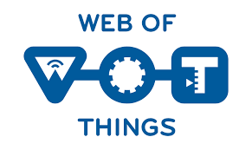
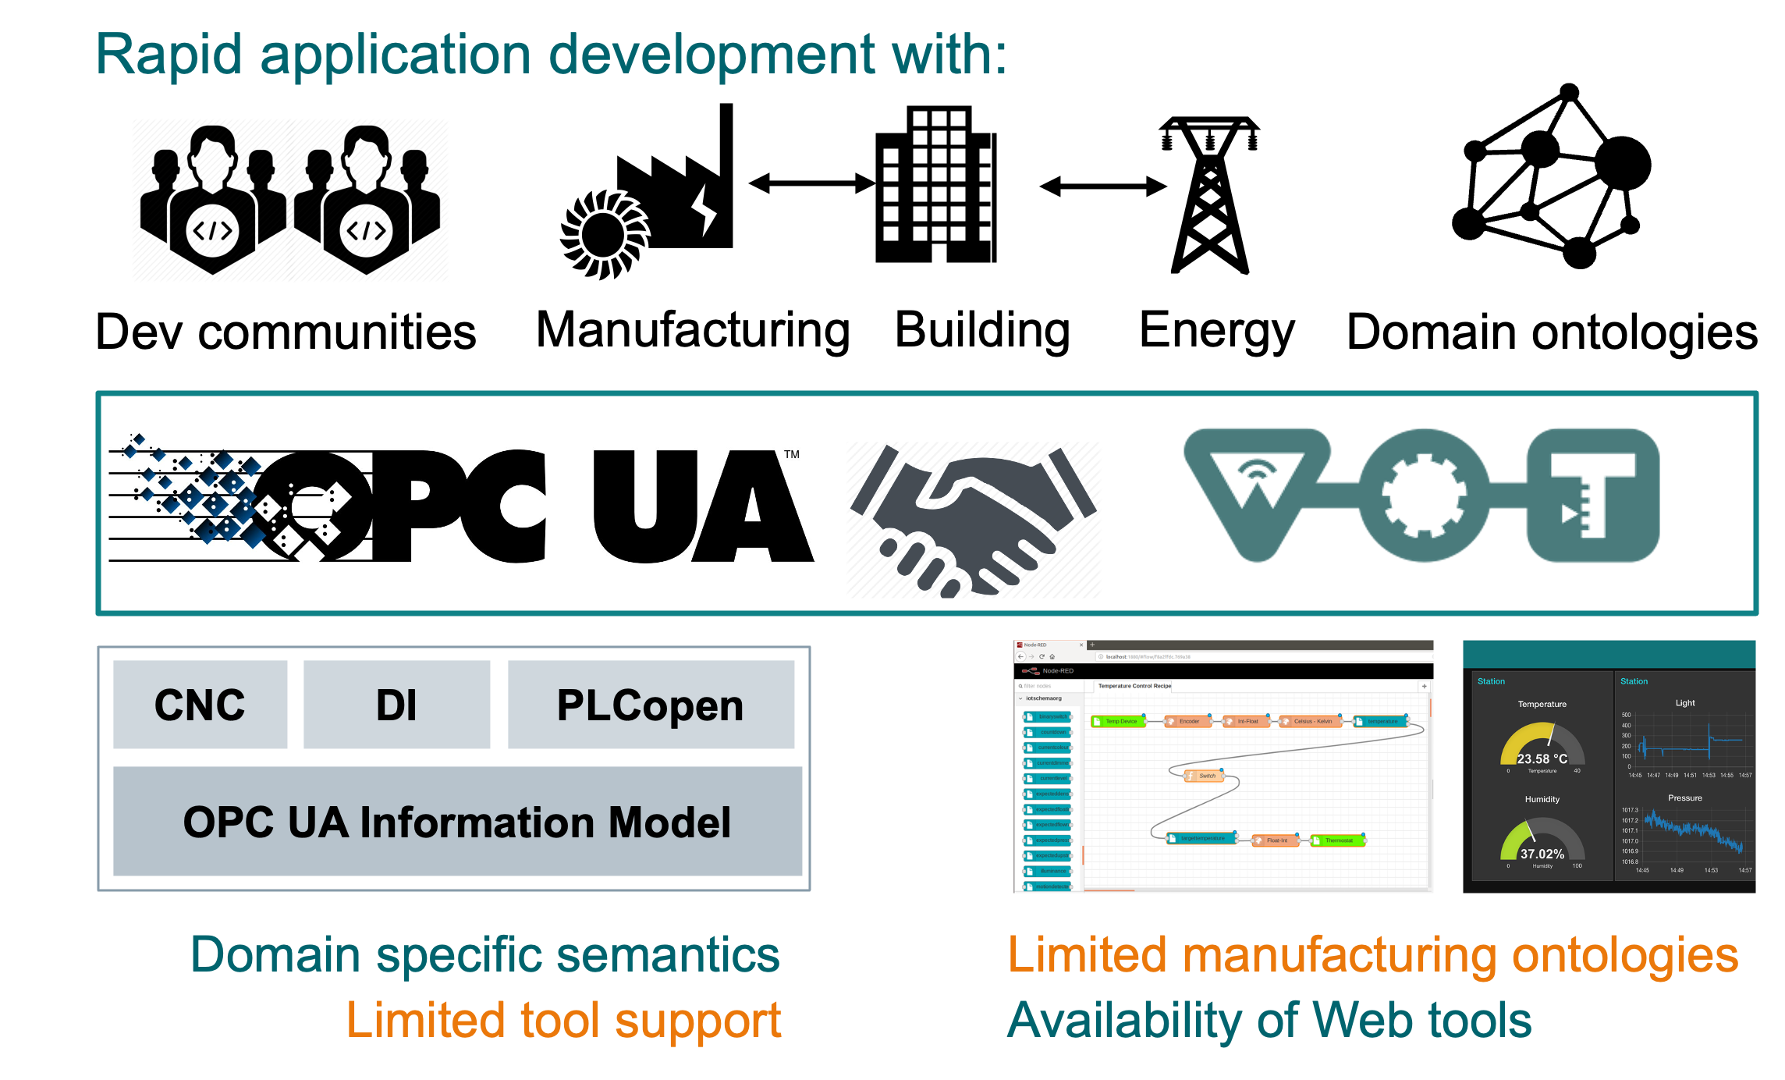
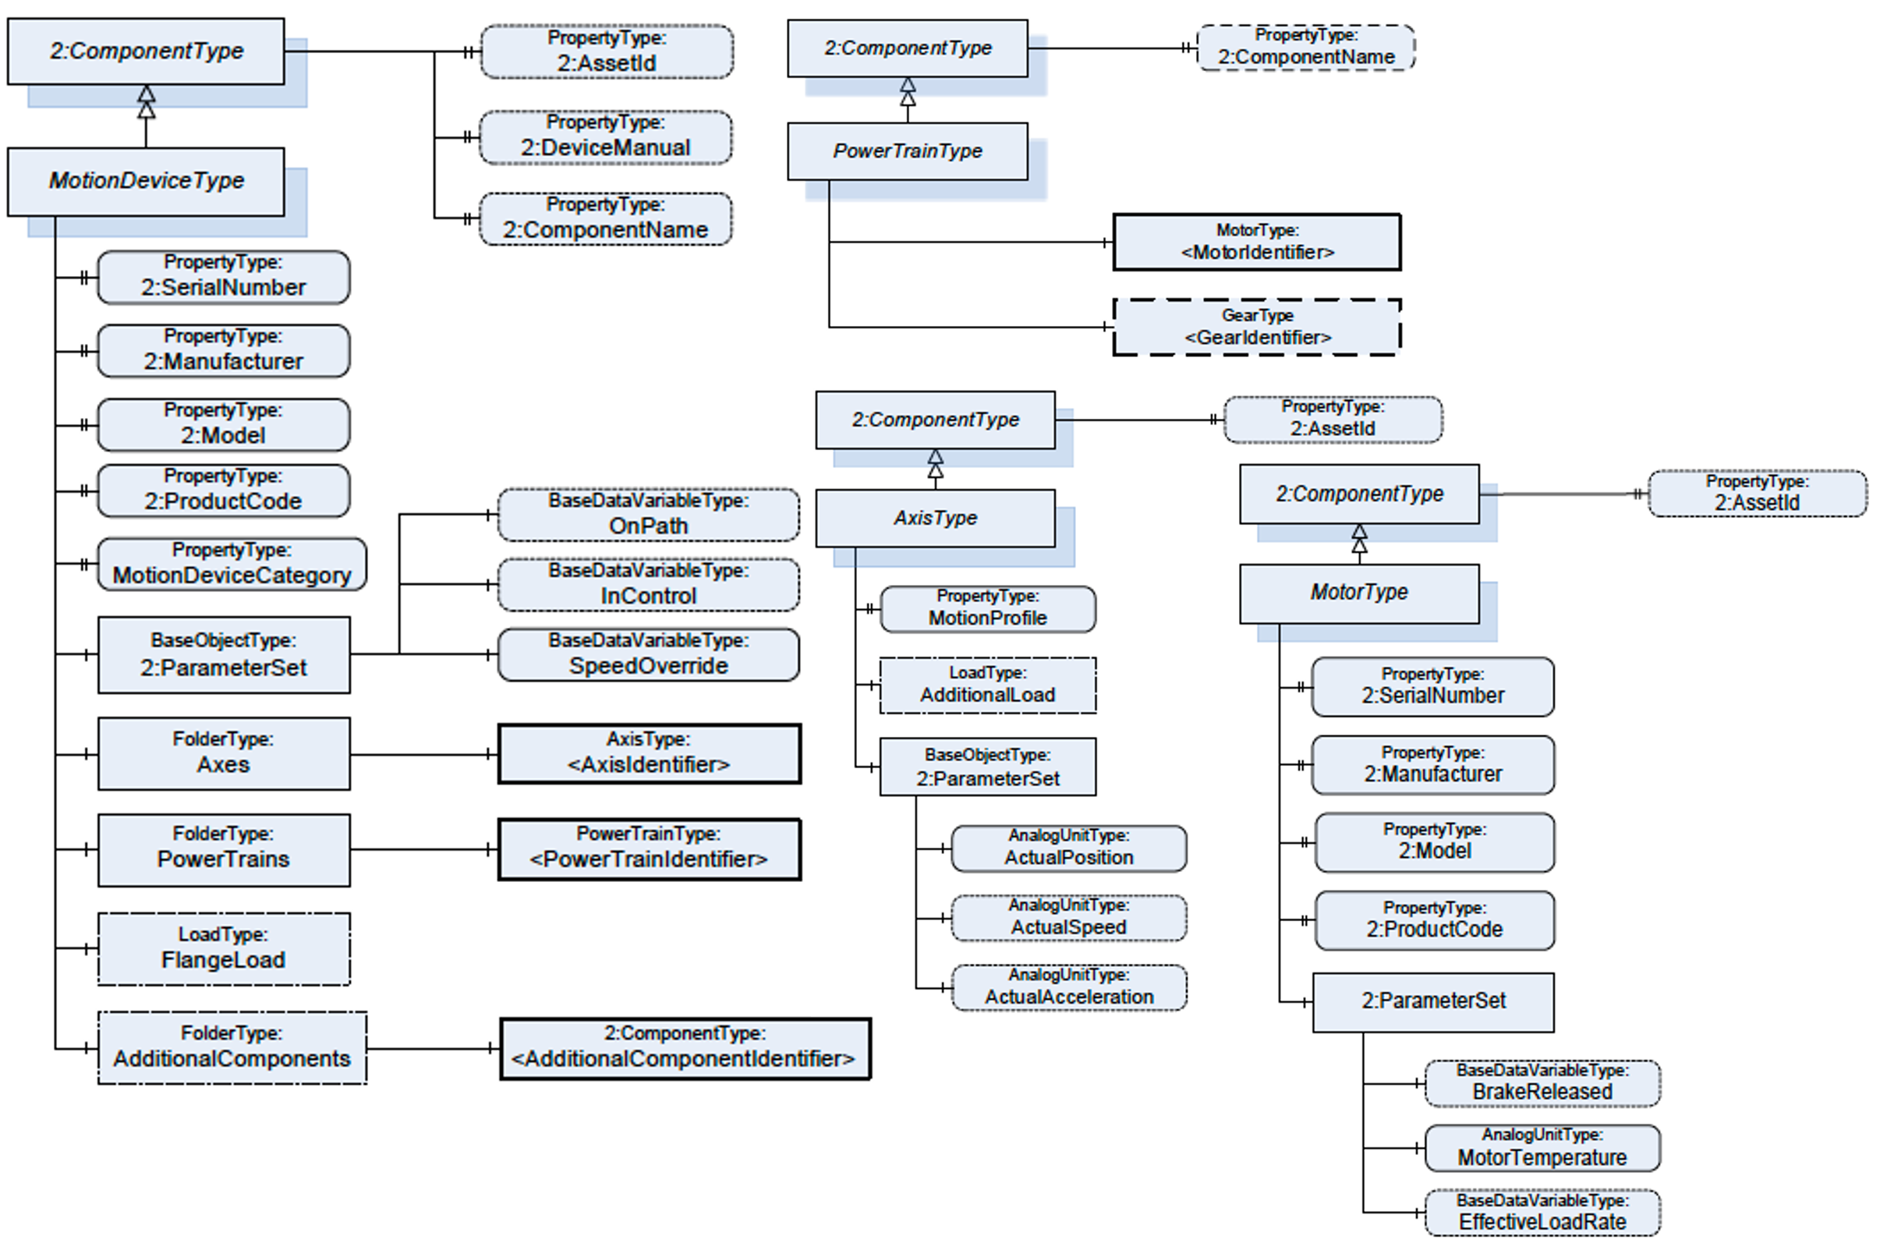
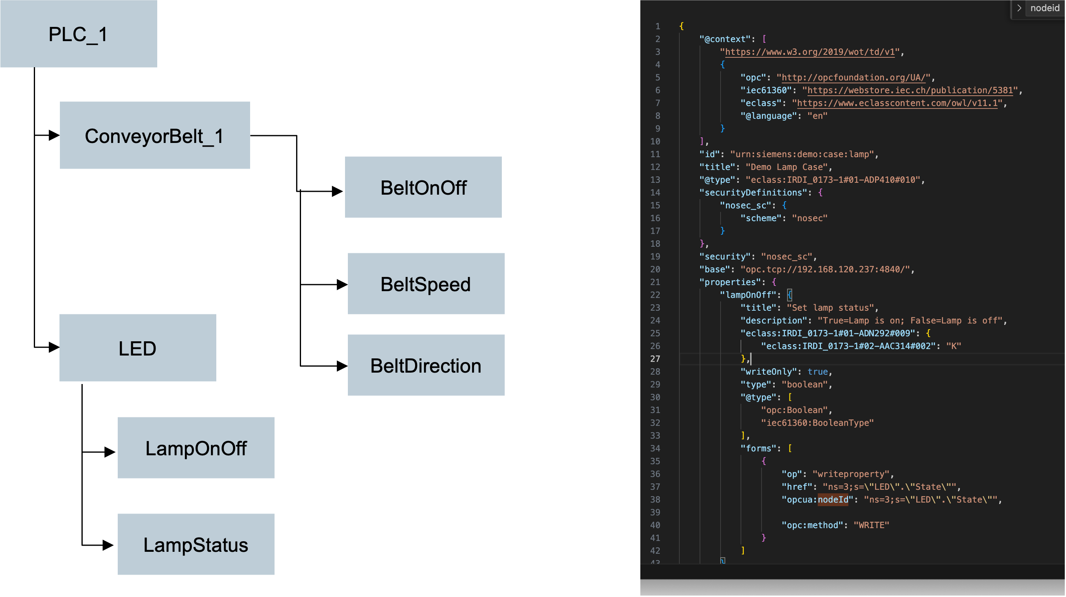
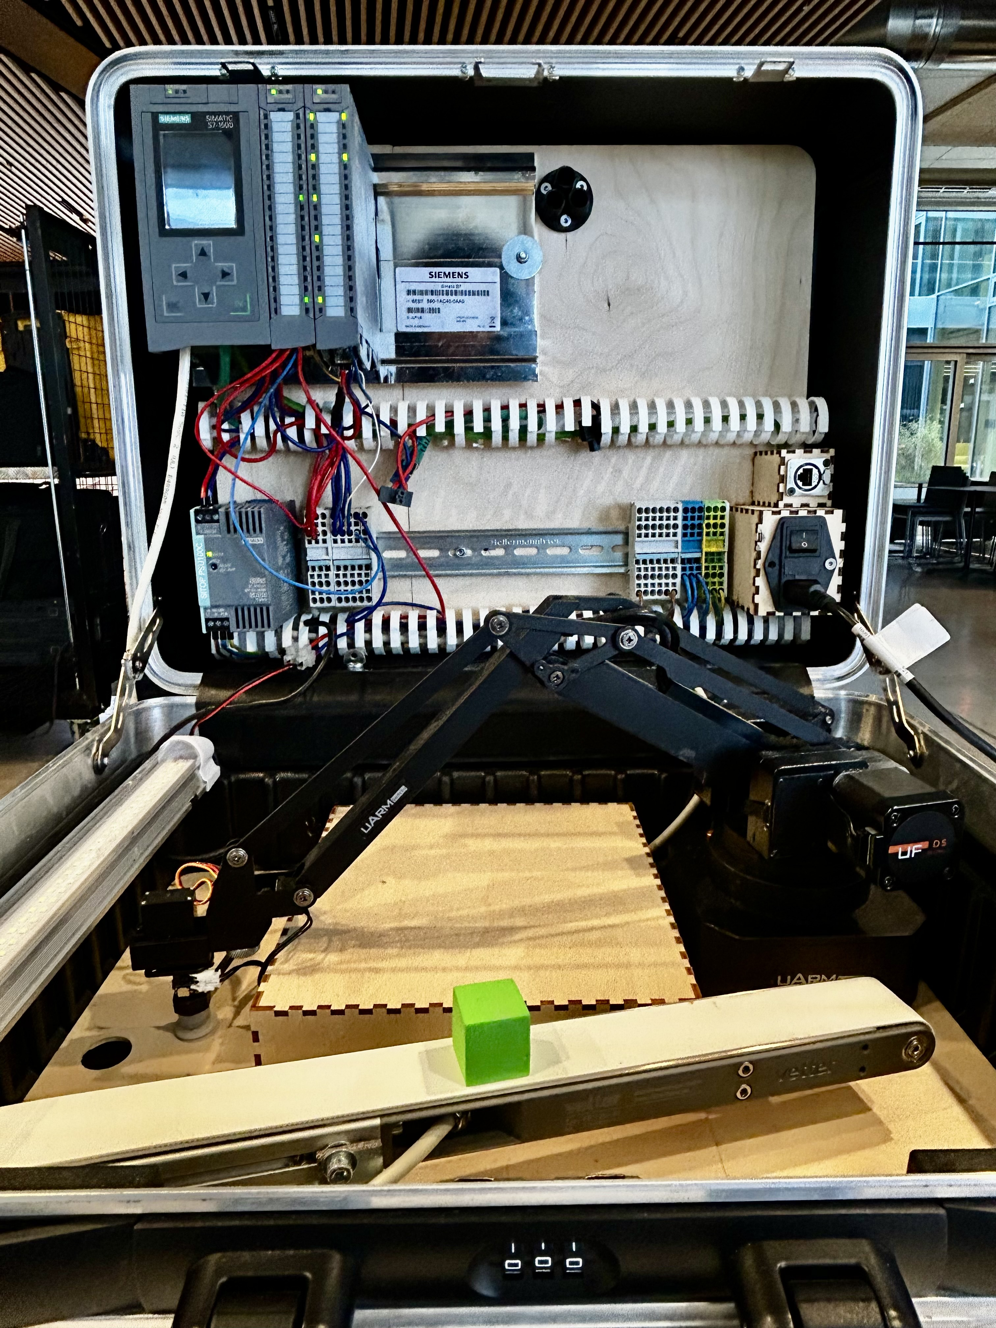
OPC UA to WoT Binding Pitch
Why?
Accelarate IoT application development with OPC UA to WoT binding
Simplify onboarding of OPC UA assets
Accelarate IT / OT data integration in Industry domain
What problem does it solve?
simple interface and access to an OPC endpoint to the user in terms
of WoT TD
How?
Expose OPC UA datapoints as W3C WoT TDs
Use WoT OPC UA binding template to read / write the data on OPC server
What do we see today?
Real deployment of an OPC server on Siemens SIMATIC S7 1500 PLC
OPC UA WoT binding in action
OPC UA data points exposed over WoT TD
OPC UA data points accessed using WoT binding templates

